Slide 1
Step 20 - Run Jenking software in EC2 instance to create a job

Slide 2
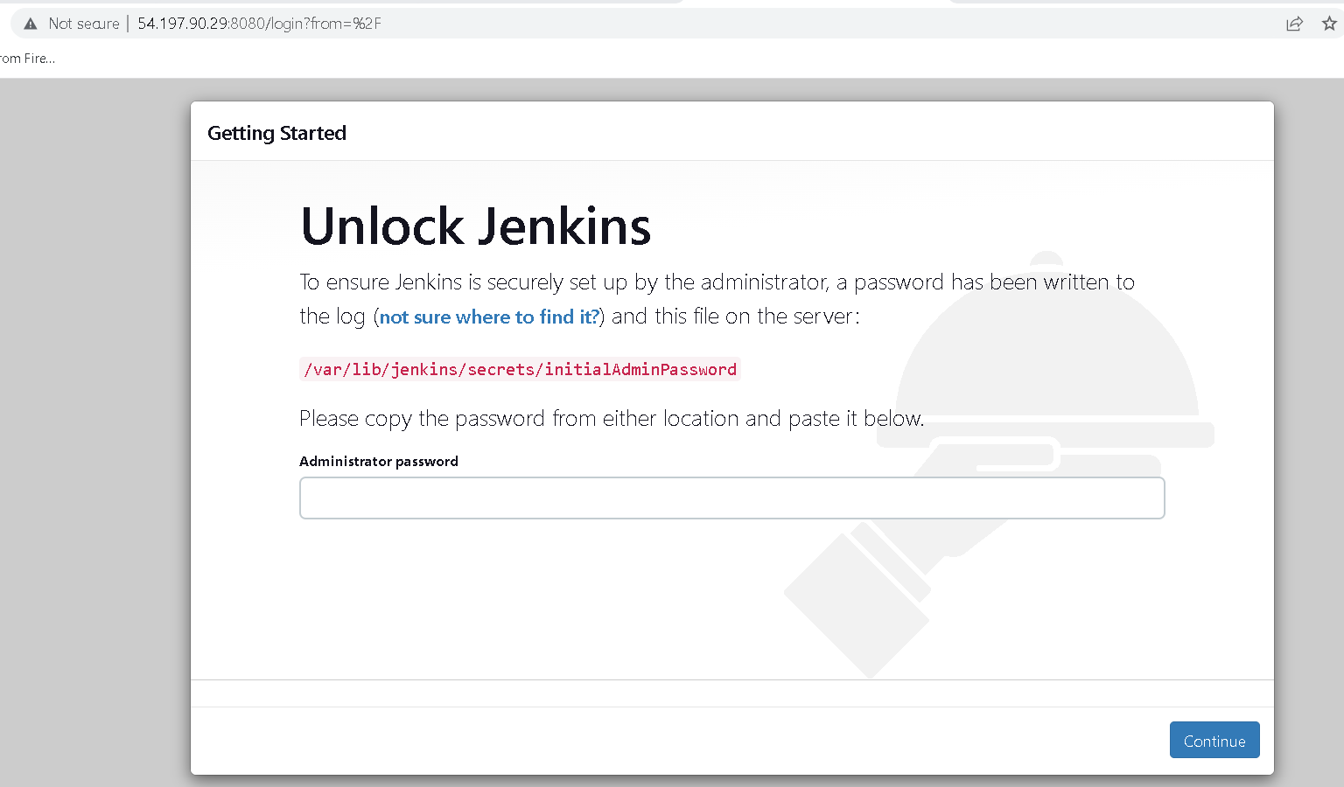
Now using IP address with port number 8080 check jenkin running or not.
For my ip address with http://3.235.130.168:8080/login?from=%2F

Slide 3
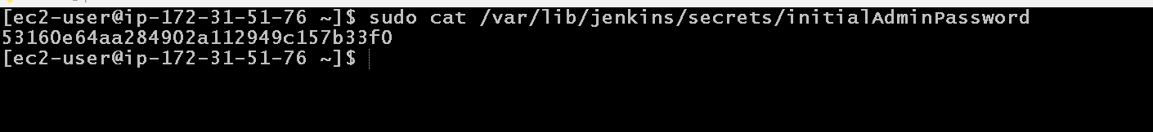
After running jenking
The default user name is :admin and password is random password generated by jenkin.
To get that password you need to run the command in ec2-instance terminal ie gitbash
sudo cat /var/lib/jenkins/secrets/initialAdminPassword

Slide 4
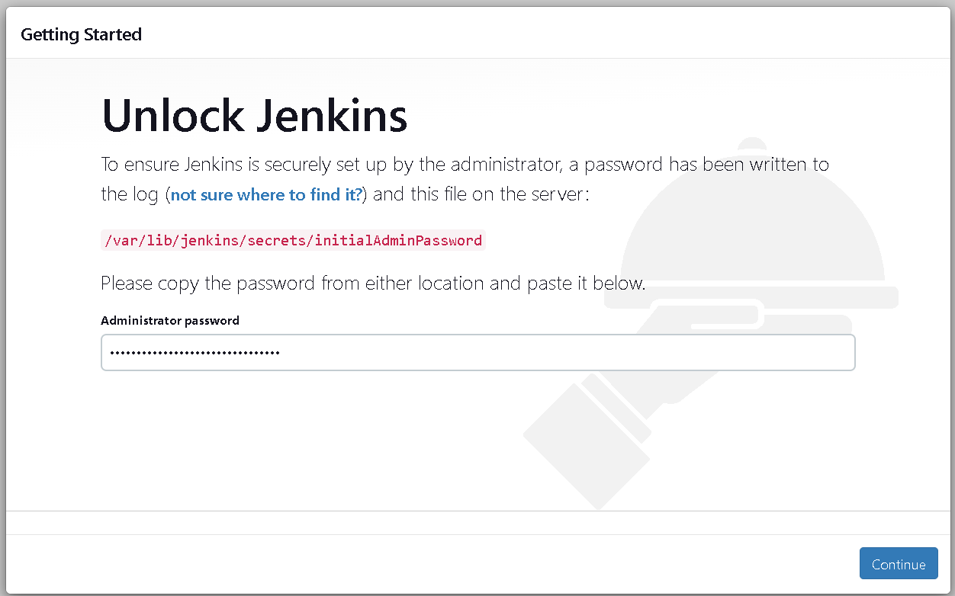
Paste this password

Slide 5
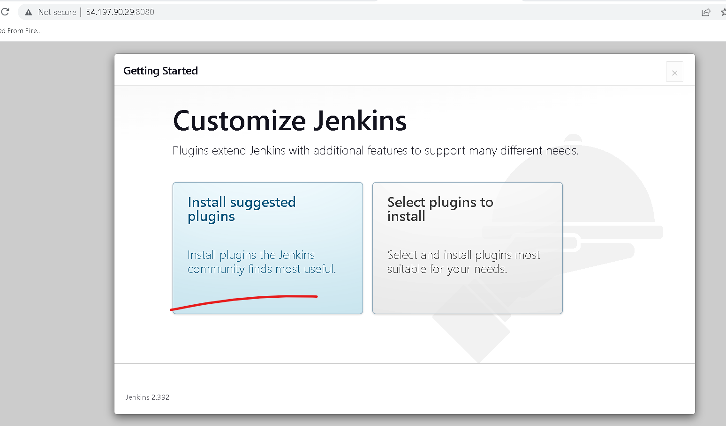
After password paste it will ask to install plugin. Please install suggested plugin

Slide 6
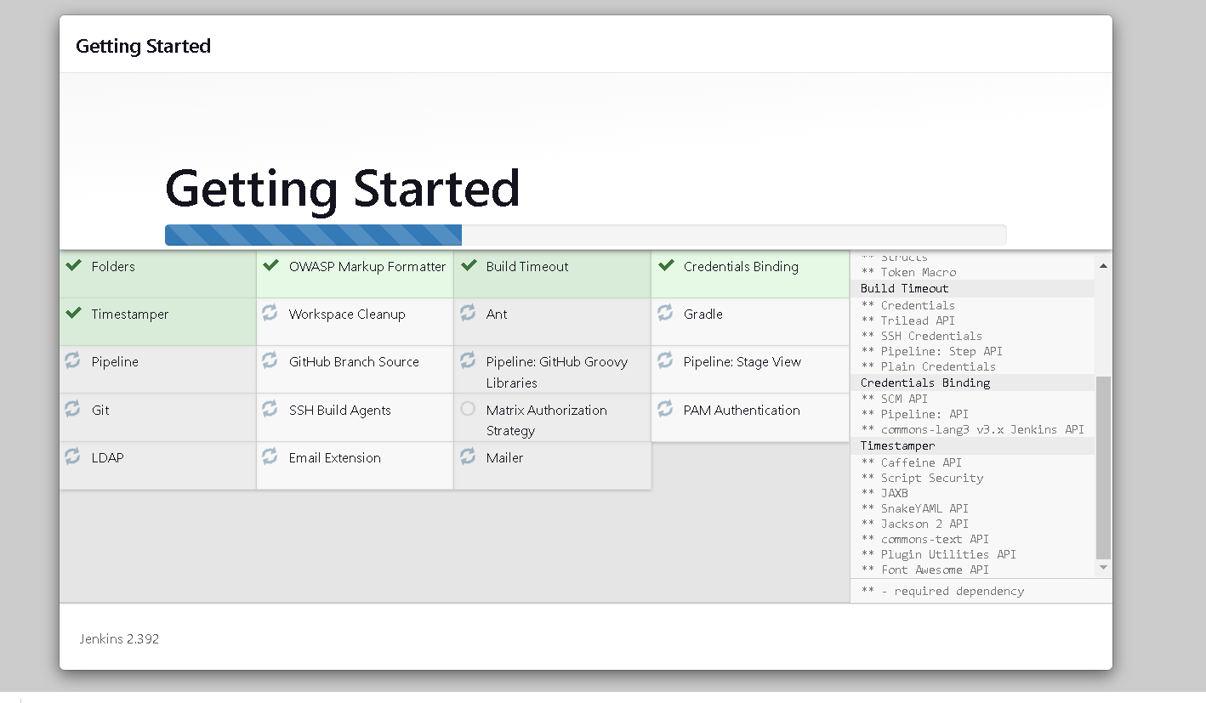
Wait to install all plugin

Slide 7
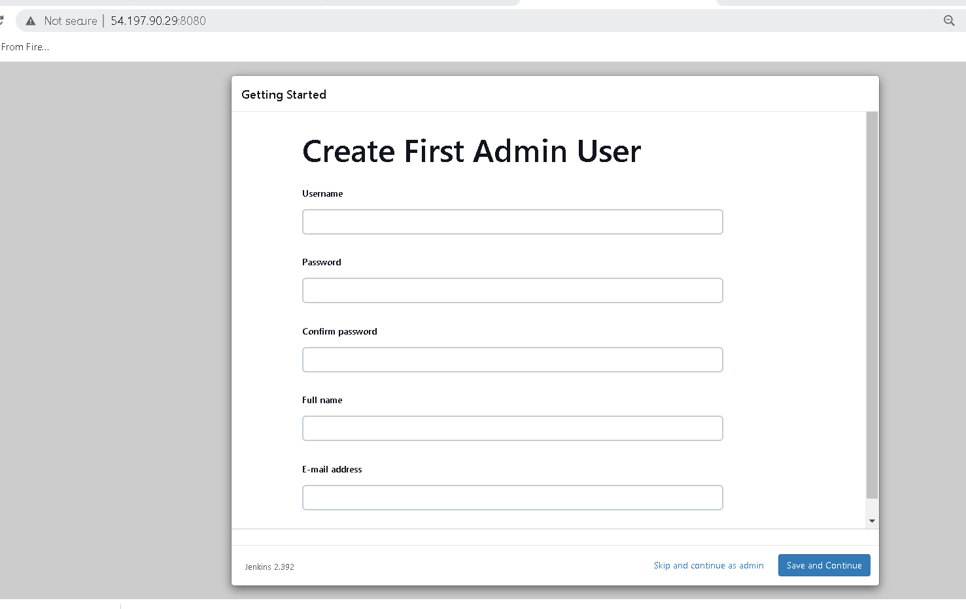
Now you need to create the account

Slide 8
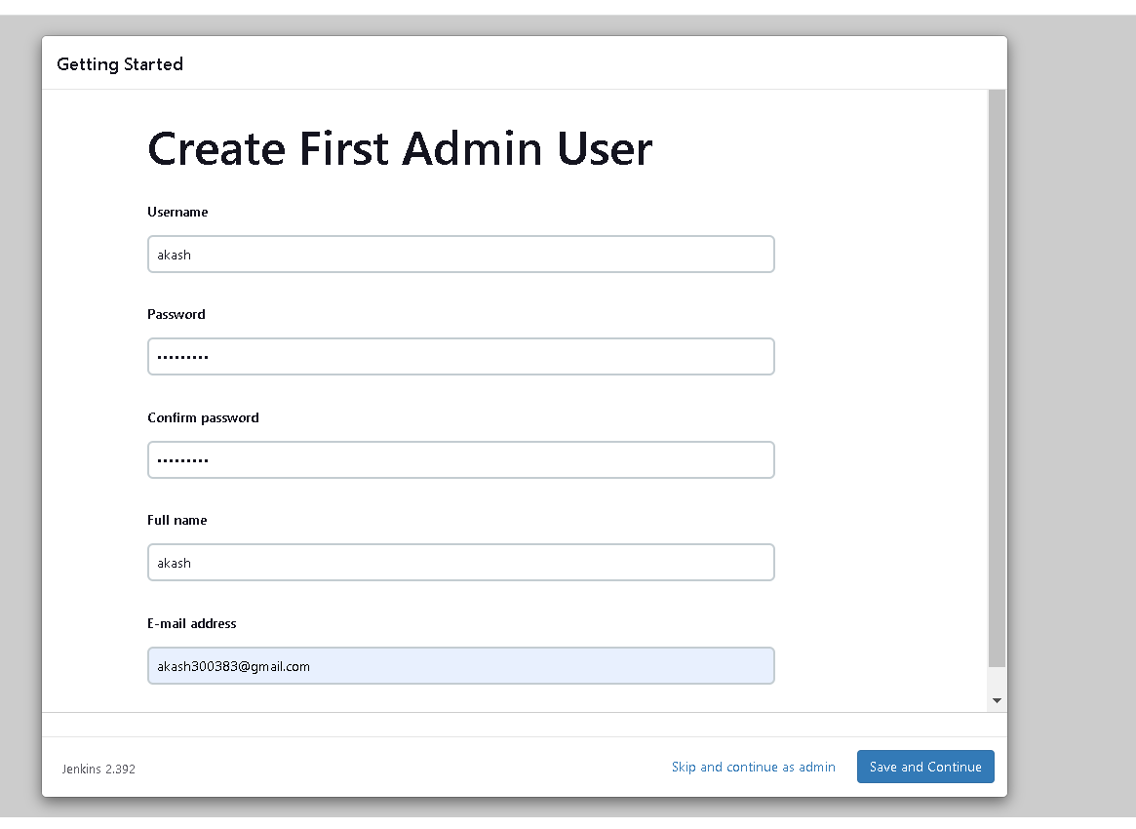

Slide 9
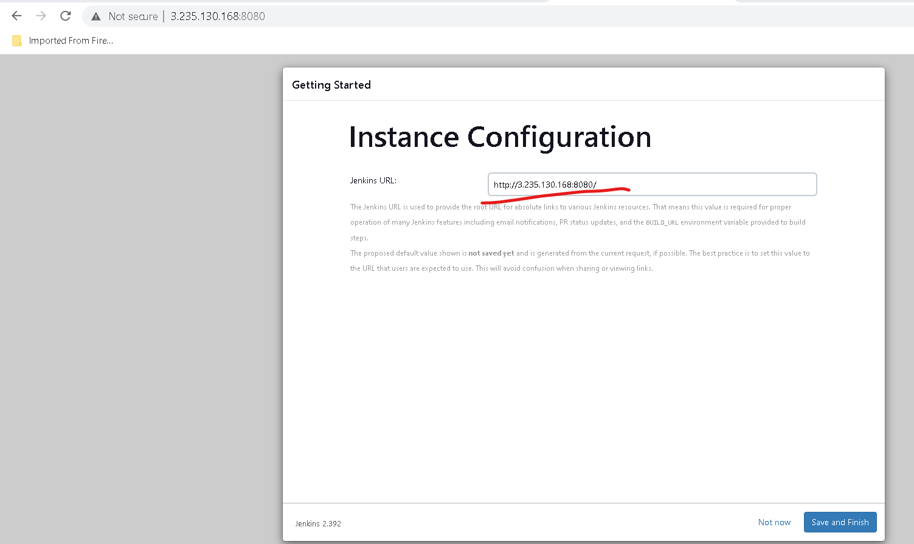

Slide 10
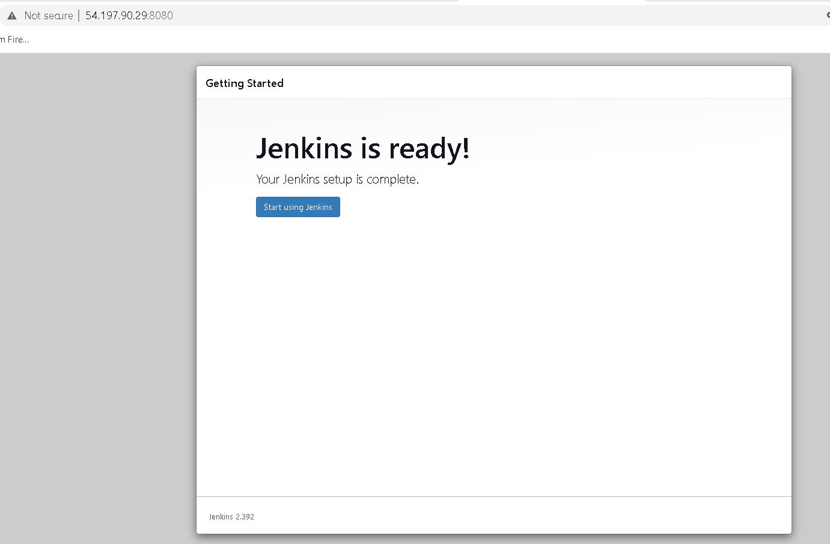

Slide 11
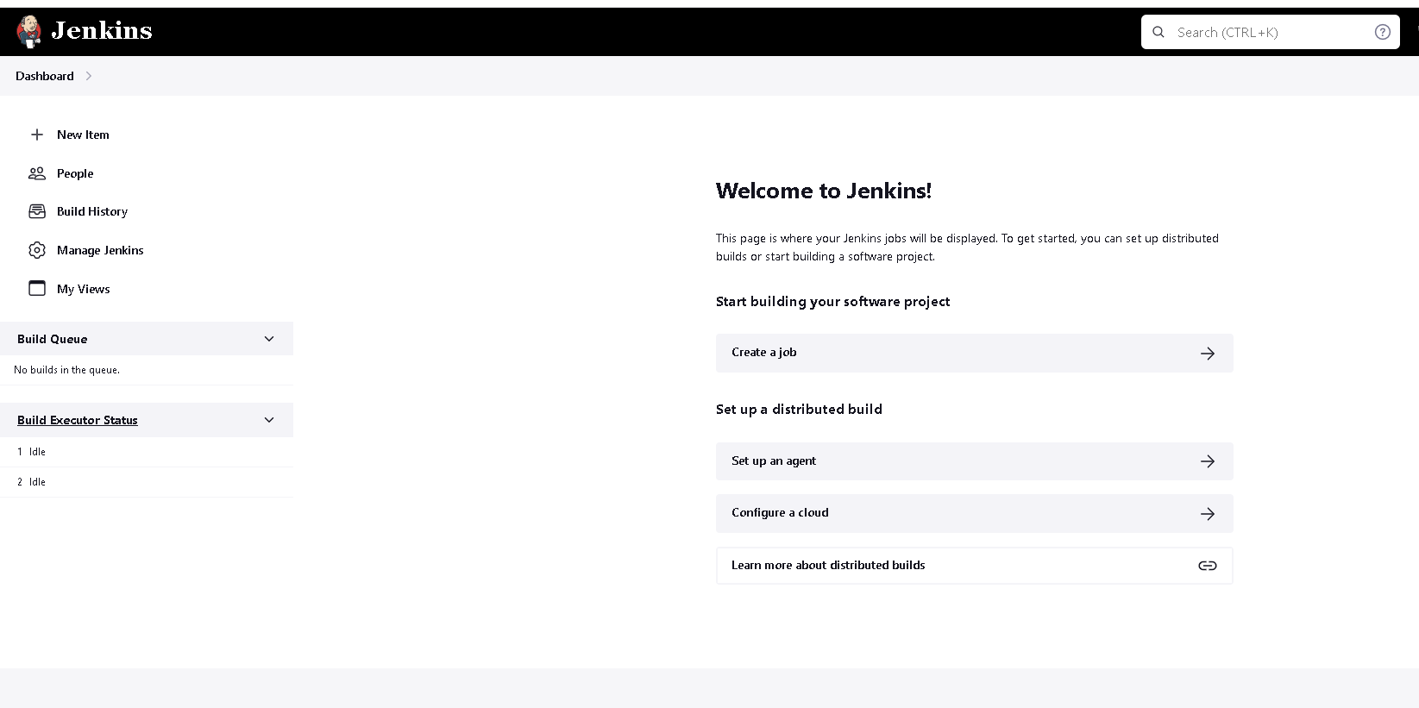
Jenkin dashboard

Slide 12
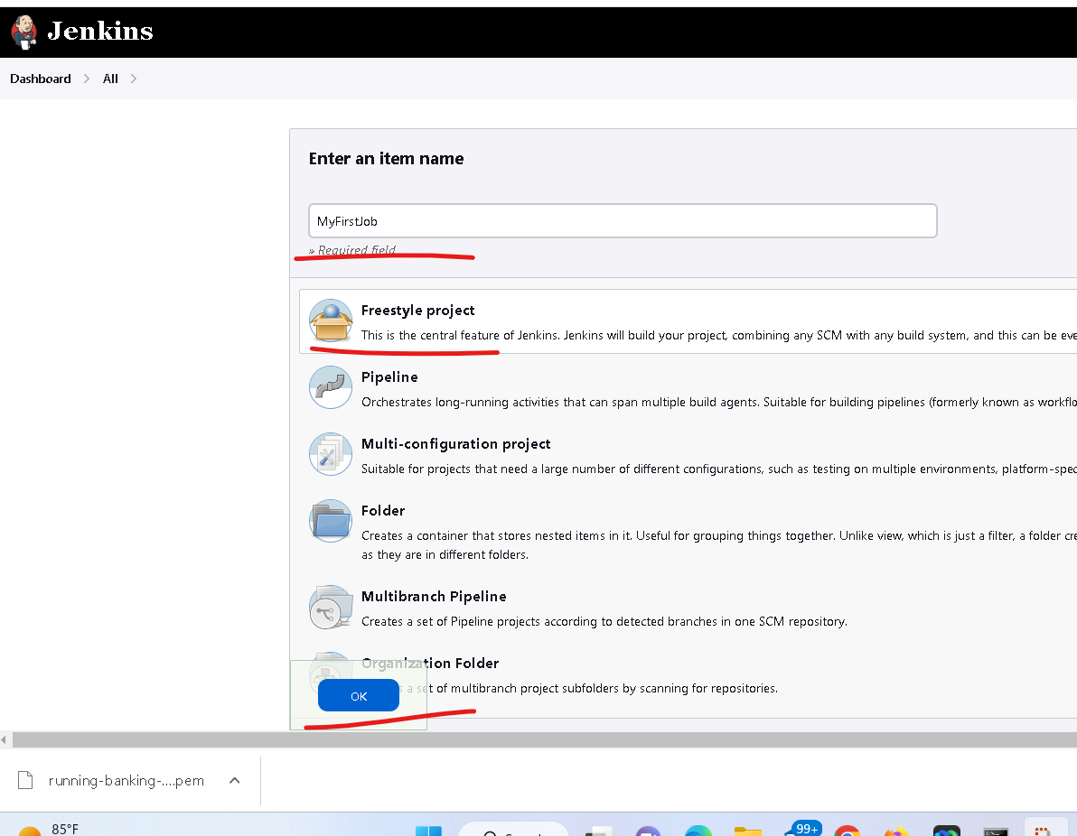
Now we will create new job

Slide 13
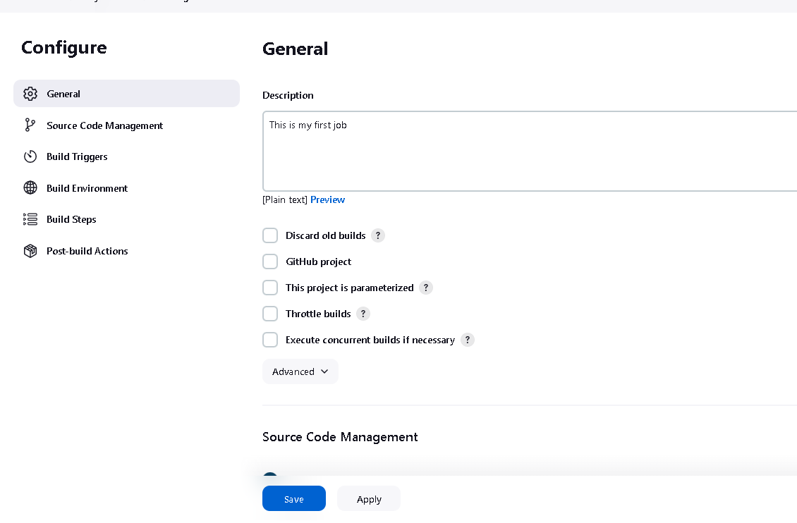
Write any description about the job

Slide 14
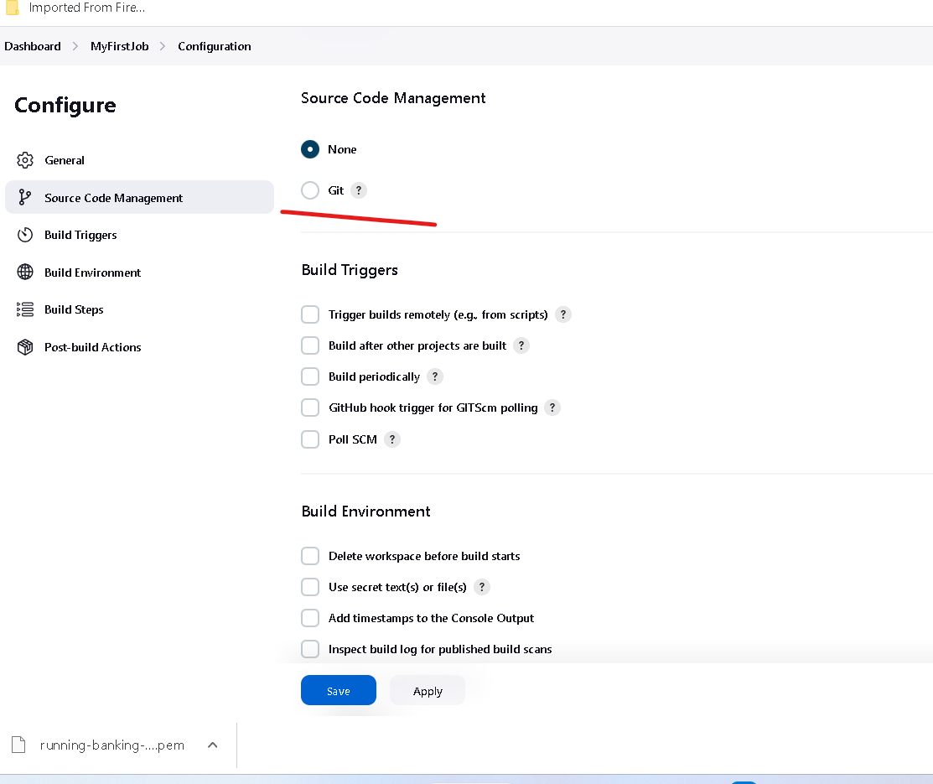
Code source management we can provide the git url

Slide 15
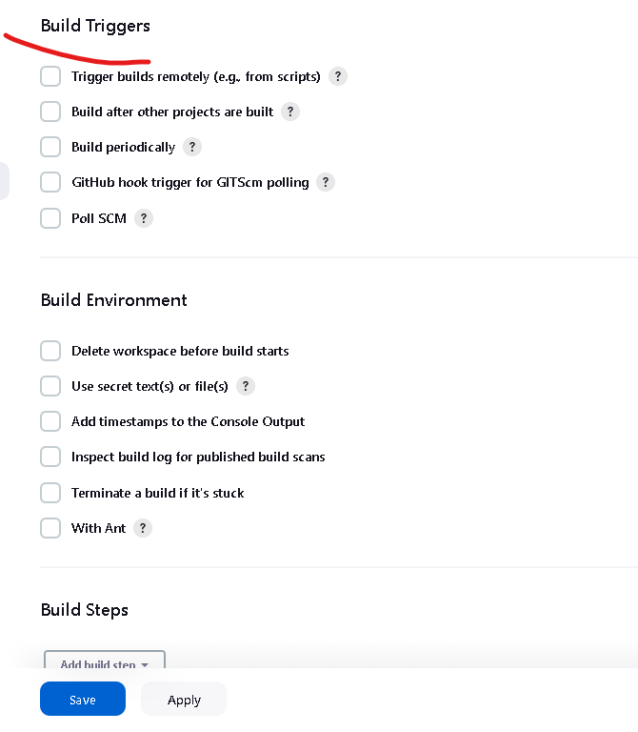
Build trigger option we can provide when the job need to triggered

Slide 16
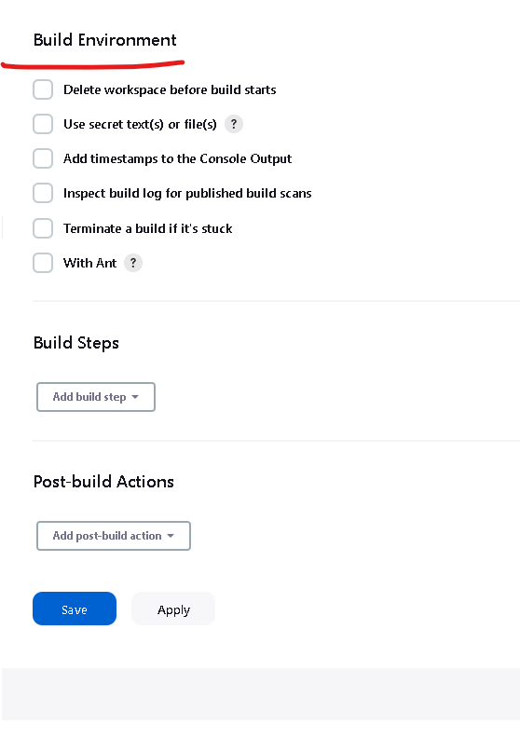
Before build you want to do any setup then you have to configure here

Slide 17
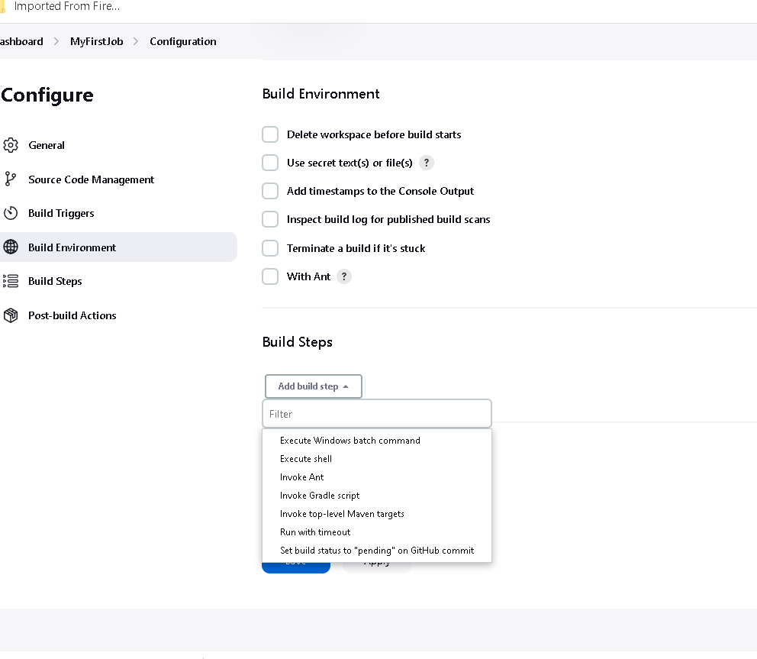
In Build steps you can write set of command which help to build the project.

Slide 18
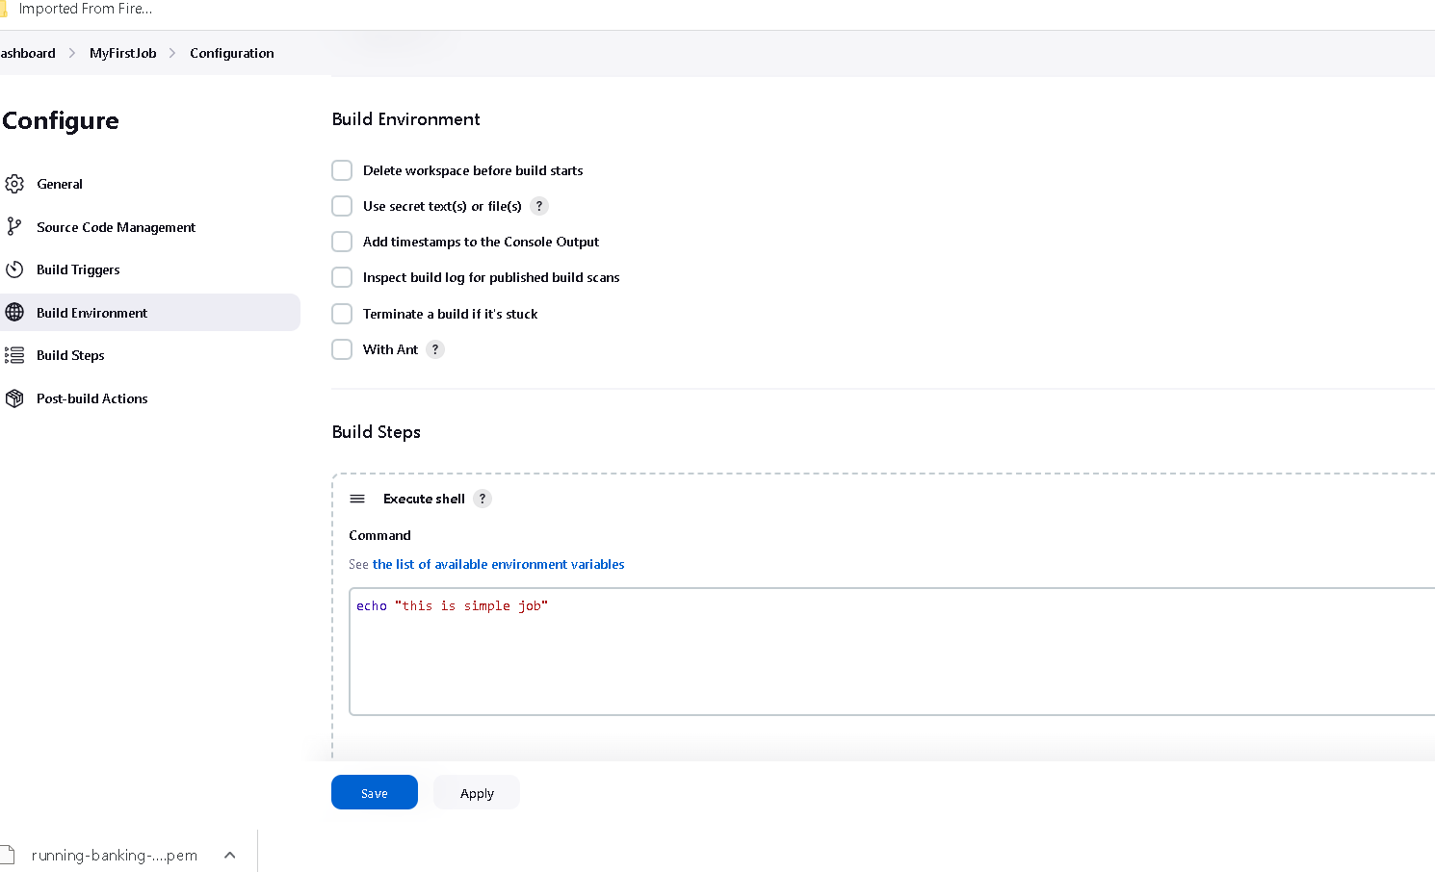
This job is responsible to display simple message

Slide 19
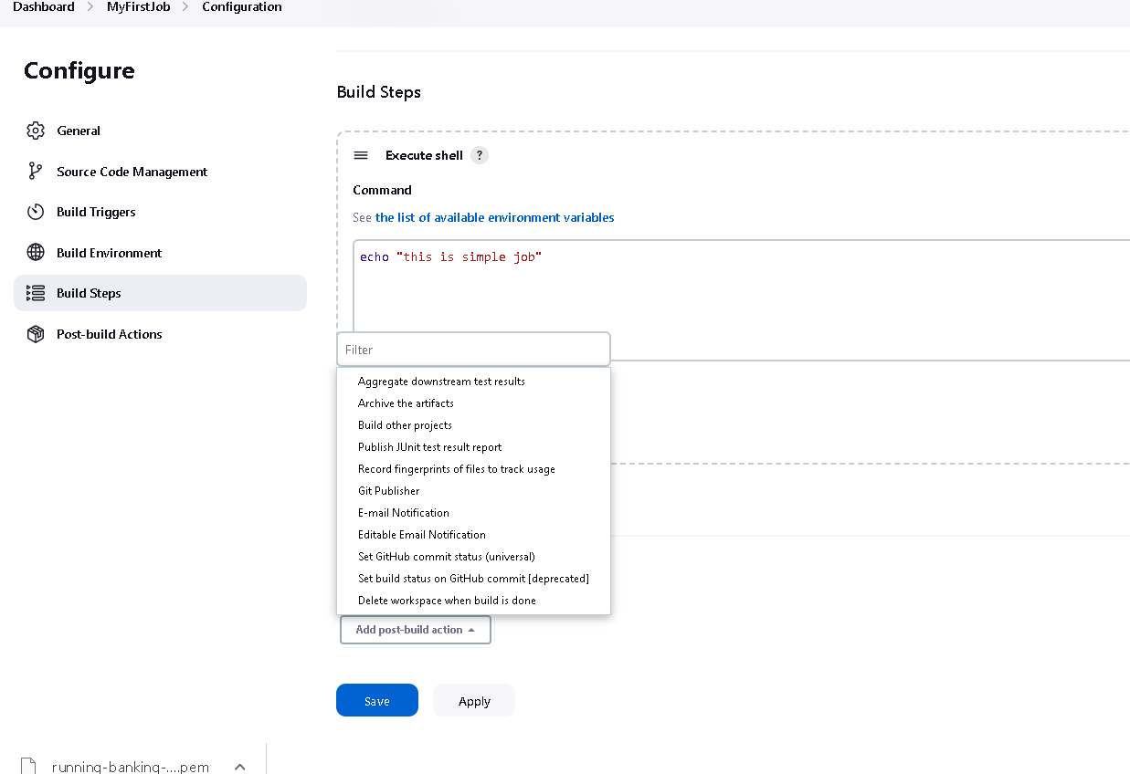
After build if you want to do any post build task that task you have to write in post build

Slide 20
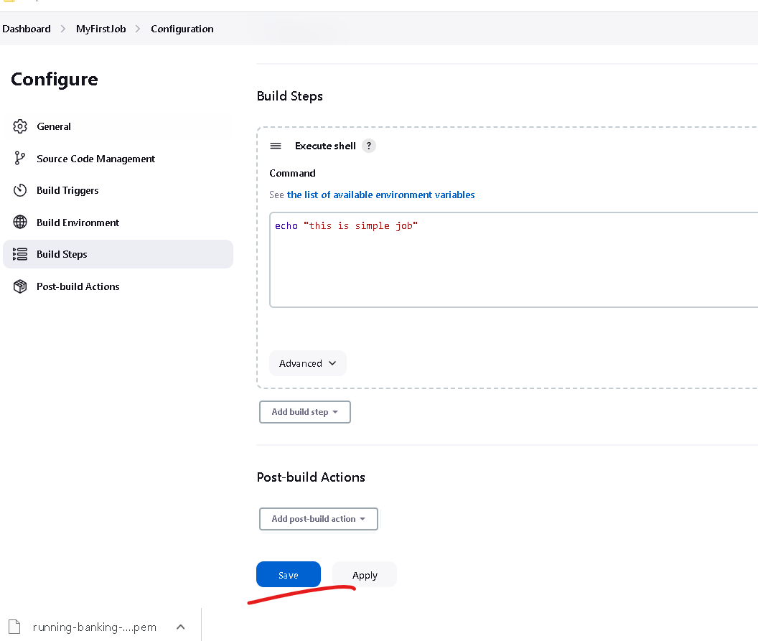

Slide 21
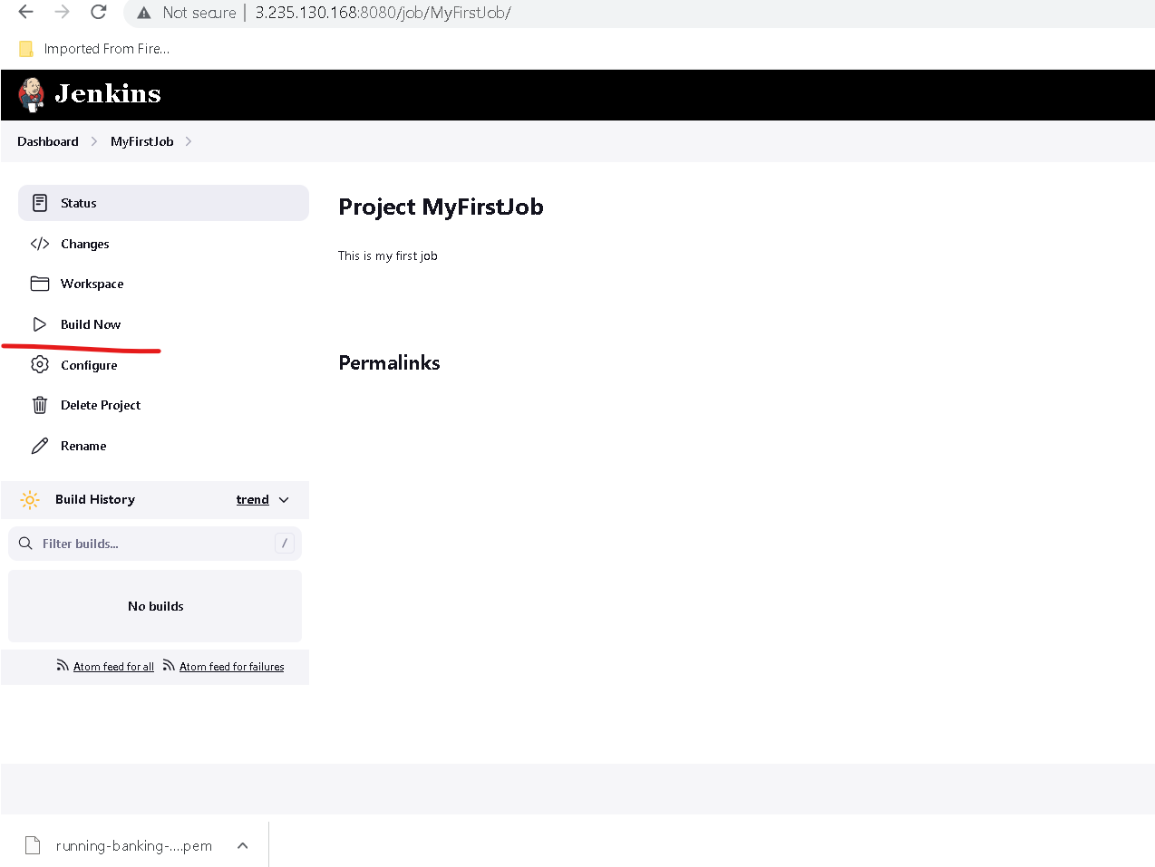
Now you have to click on build now

Slide 22
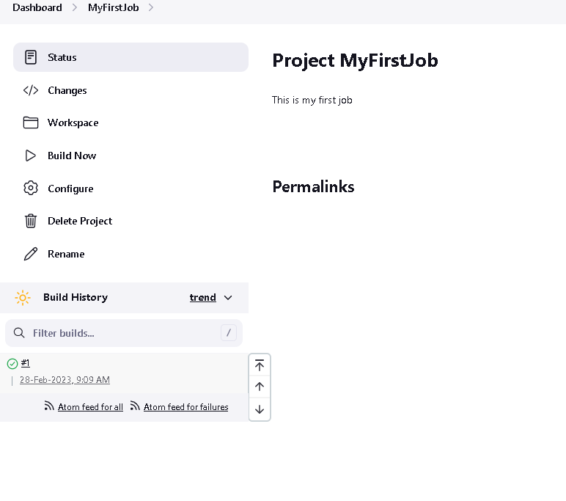
If it build success we will get green color else we will get red color

Slide 23
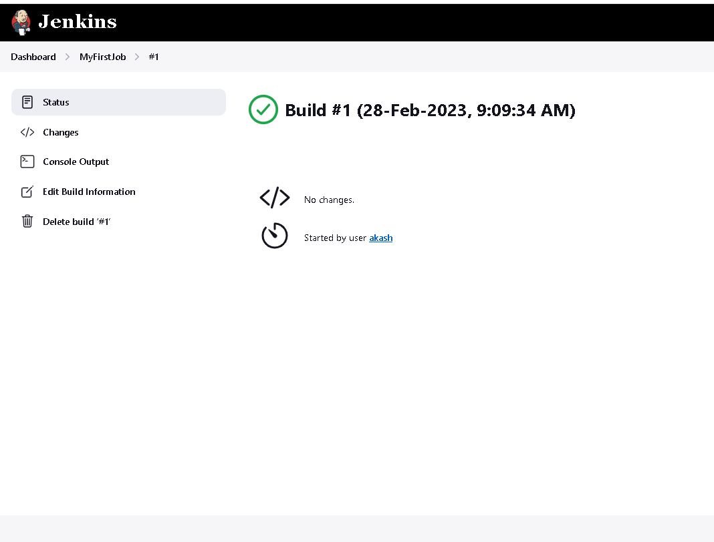
Once you click on hyperlink

Slide 24
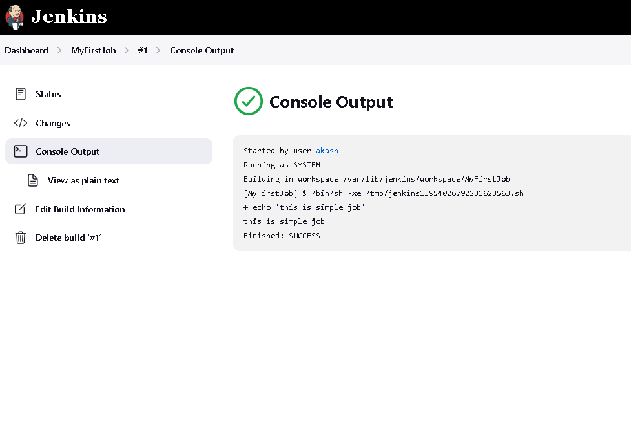
Now you have to click on console output

